Slide 1
WindCube FPI
Calibration Pipeline — Steps 1 through 7
From raw binary image → dark subtraction → centre finding → annular reduction
→ peak fitting → Tolansky two-line WLS → seeds passed to H05
run_windcube_calibration.py + fpi_cal_lib.py · CAL01 · 2026-05-27

Slide 2
Pipeline overview
Eight steps from raw binary to calibrated instrument parameters
1
File select
2
Load & dark sub
3
Centre find
4
Annular reduce
8
H05 inversion
7
Tolansky WLS
5–6
Peak ID & fit
This deck covers steps 1–7. Step 8 (H05 inversion) is covered in the separate H05→H06 handoff deck.
Figures produced: Fig 0 · Fig 1 · Fig 2 · Fig 3a/3b · Fig 4 · Fig 5 · Fig 5b → _cal_result.npy (Step 8)

Slide 3
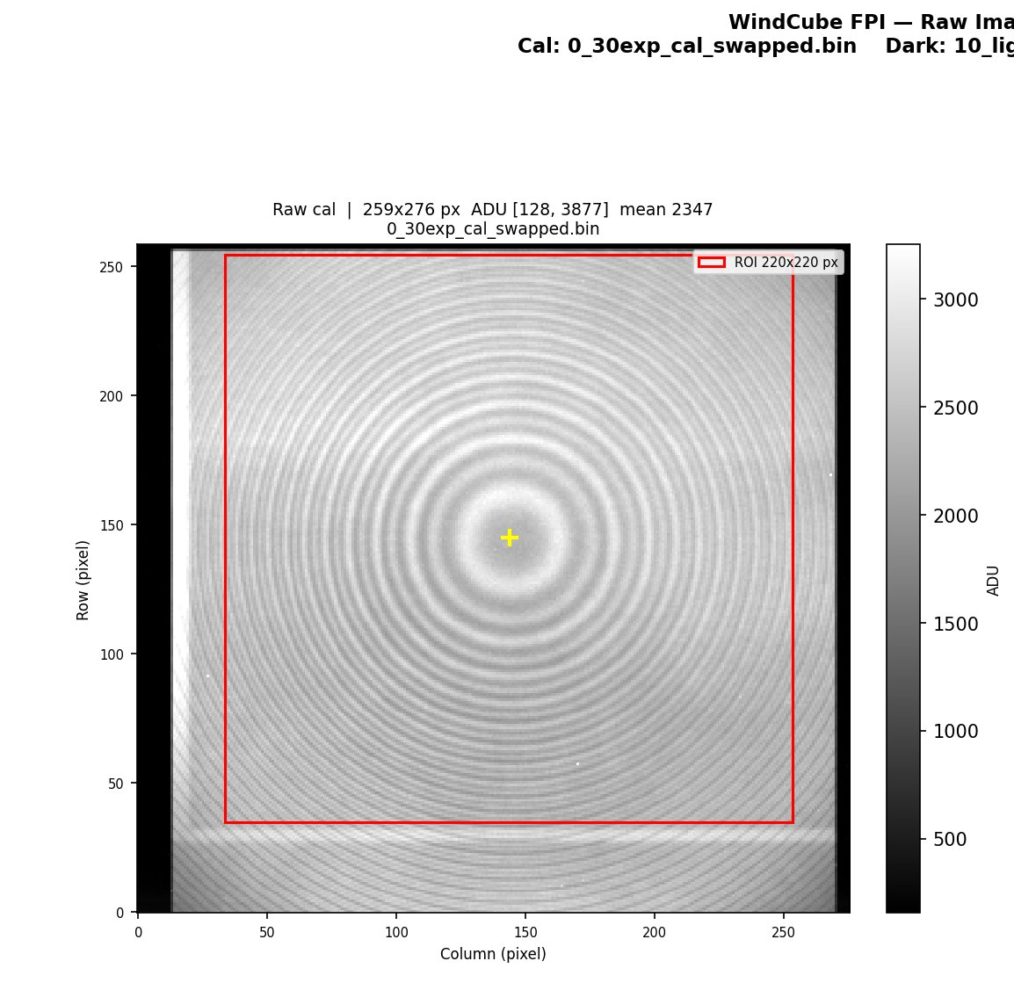
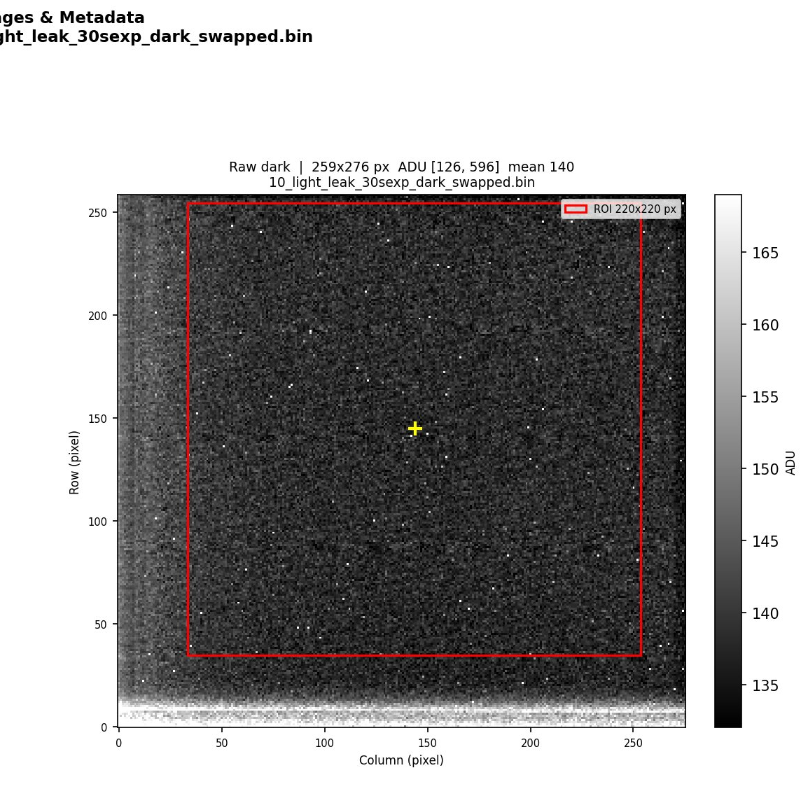
Steps 1 & 2 — File selection, loading, dark subtraction
Produces the dark-subtracted ROI that all subsequent steps operate on
Step 1 — File selection
Step 2 — Load & dark subtract
USE_DIALOG flag selects between:
• Windows tkinter dialog (_pick_file)
• Hardcoded paths for production runs
Selects one CAL .bin and one DARK .bin.
Output directory = one level above cal file.
_load_raw() decodes big-endian uint16 binary:
header row → exp time, image type, lamps
pixel array → float64 image
Dark subtracted full frame; floor at 0.
ROI extracted: 220×220 px centred on seed.
Figure 0 — 0_cal_raw_images_metadata.png
[0,0] Raw cal image (full frame, ROI box overlay) [0,1] Raw dark image (full frame)
[1, :] Metadata table — exp time, CCD temp, timestamp, lamp/shutter status, etalon temps
[2,0] Dark-subtracted ROI (220×220 px, seed crosshair) [2,1] ROI pixel histogram
fpi_cal_lib: (none — local helpers only)

Slide 4
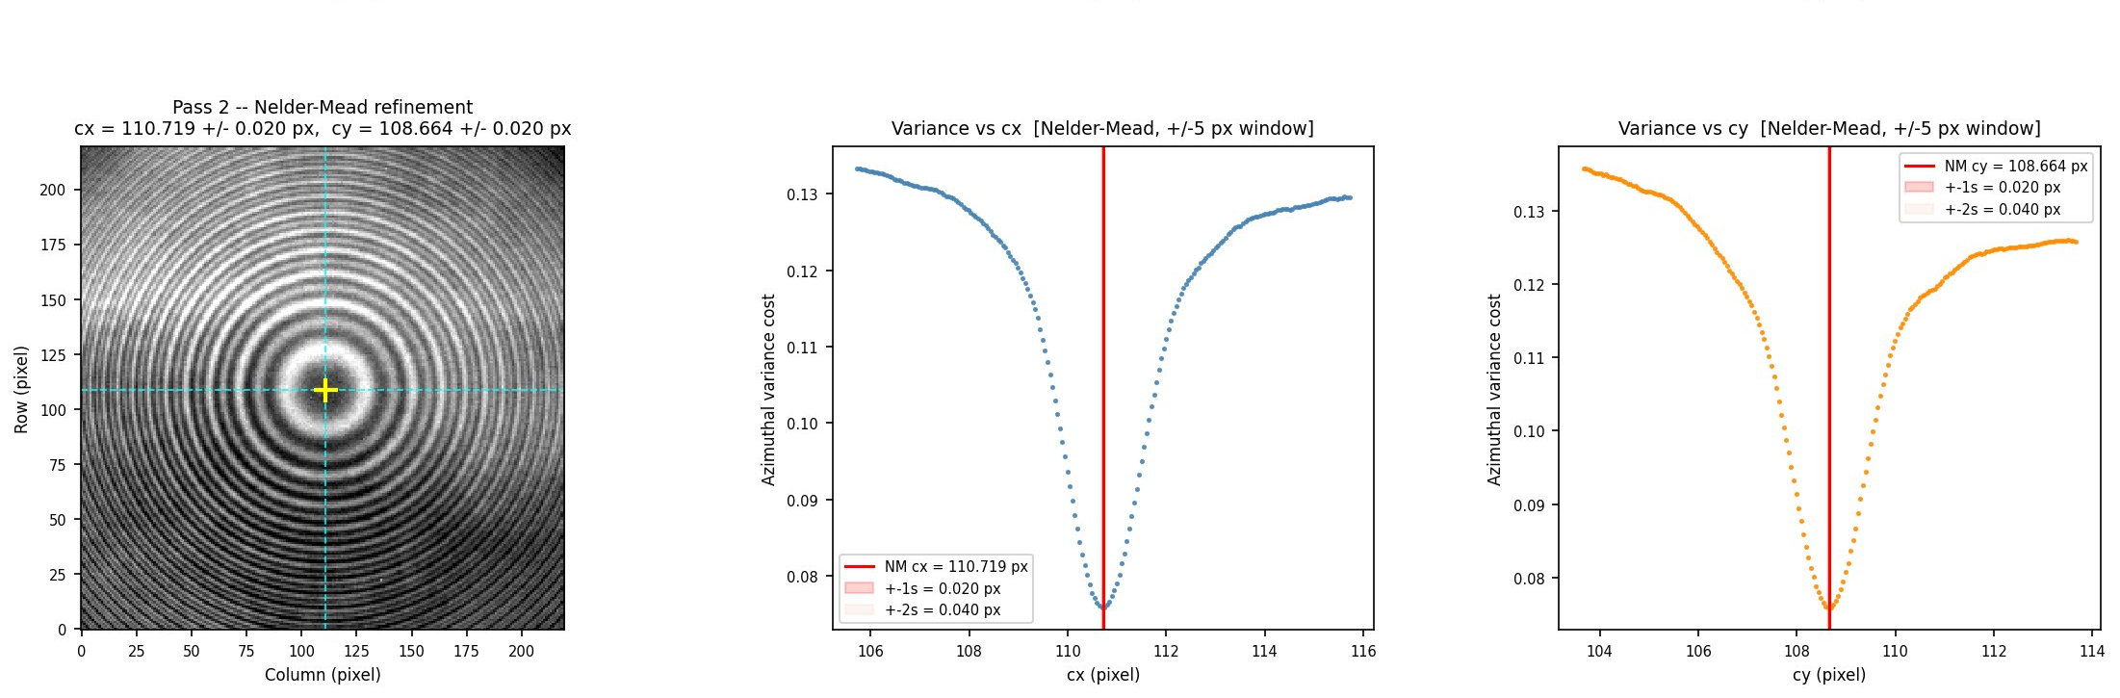
Step 3 — Two-pass azimuthal variance centre finding
Locates the optical axis of the fringe pattern to sub-pixel accuracy
Pass 1 — Coarse grid search
Pass 2 — Nelder-Mead refinement
20×20 grid over ±VAR_SEARCH_PX (15 px)
around ROI geometric centre.
Evaluates _variance_cost() at each point.
Retains (grid_cx, grid_cy) at minimum.
scipy.optimize.minimize(Nelder-Mead)
seeded from Pass 1 best point.
Returns (cx, cy) ± 1σ from cost-surface
curvature (finite-difference Hessian).
Typical σ < 0.1 px.
_variance_cost(cx, cy, image)
Figure 1 — Centre finding
Bins pixels into r² annuli. Returns Σ(per-bin variance).
Minimum when cx,cy coincide with the true optical axis.
Outer hot pixels clipped at 99.5th percentile before cost eval.
2×3 grid: fringe image with crosshair,
variance vs cx (coarse + fine),
variance vs cy (coarse + fine).
Output → CentreResult: cx, cy, σ_cx, σ_cy, 2σ_cx, 2σ_cy, cost_at_min, grid_cx, grid_cy
fpi_cal_lib: find_centre(), _variance_cost(), CentreResult

Slide 5
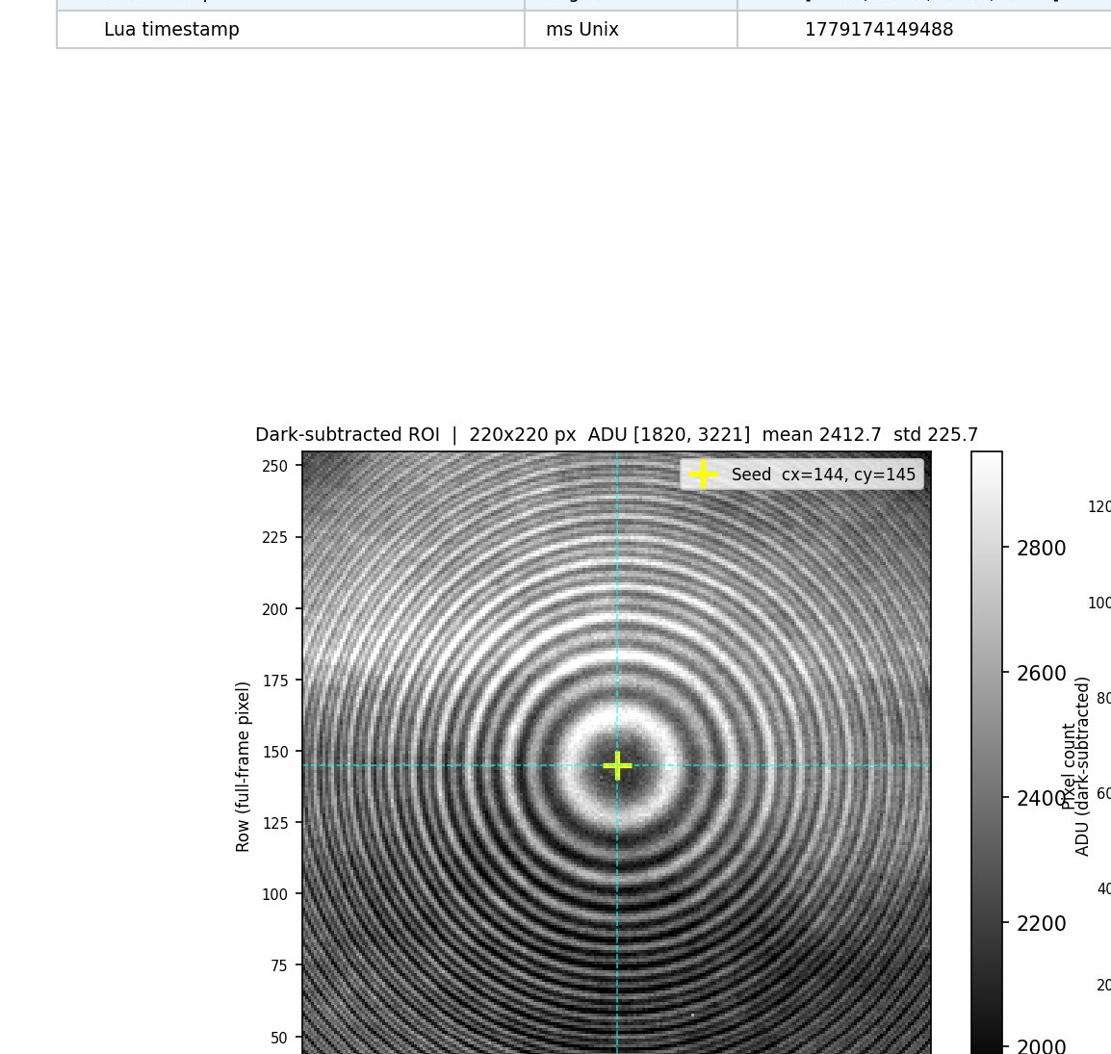
Step 4 — Annular reduction (Mulligan r² binning)
Collapses the 2-D fringe image to a 1-D radial intensity profile I(r²)
Binning
Statistics per bin
Peak finding
r² bins: n_bins=1500
over r=0 → R_MAX_PX=150 px
(~43 bins/FWHM)
Each pixel votes into its r² bin.
Duplicates removed per (pixel,bin)
pair before accumulation.
Mean ADU → profile[b]
Std / √N_pix → sigma_profile[b]
(SEM — standard error of mean)
3σ outlier clip per bin.
Bins < 3 pixels → masked.
Sparse flag if >10% masked.
Two passes:
1) _find_and_fit_peaks()
Gaussian fits in r domain
2) _find_and_fit_peaks_r2()
Parabolic primary + Gaussian
fallback in r² domain
Uses _R2_WINDOWS lookup
(user-defined per peak)
Output → FringeProfile: profile, sigma_profile, r_grid, r2_grid, n_pixels, masked, cx, cy, peak_fits, peak_fits_r2
Key tunable params: R_MAX_PX=150 · N_BINS=1500 · PEAK_PROMINENCE=20 ADU · _R2_WINDOWS (34 entries, P0–P31)
fpi_cal_lib: annular_reduce(), FringeProfile, PeakFitR2

Slide 6
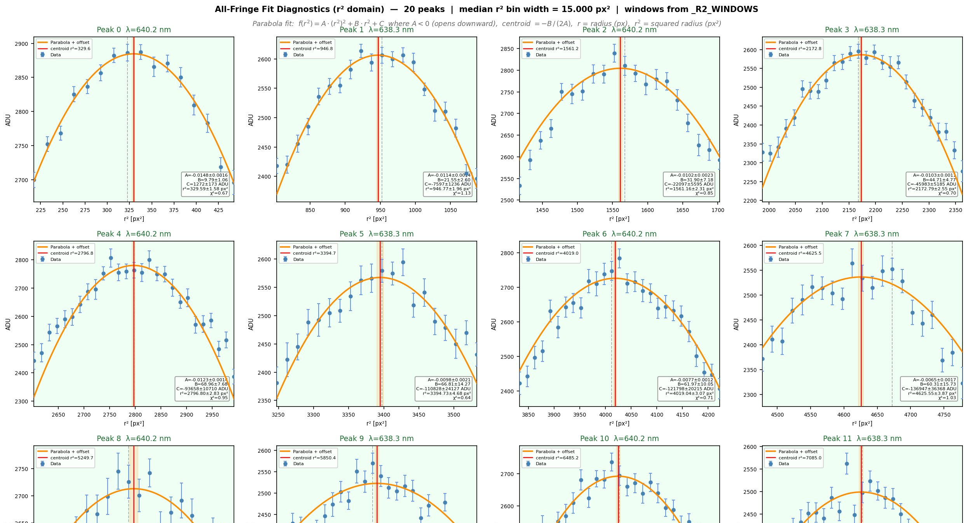
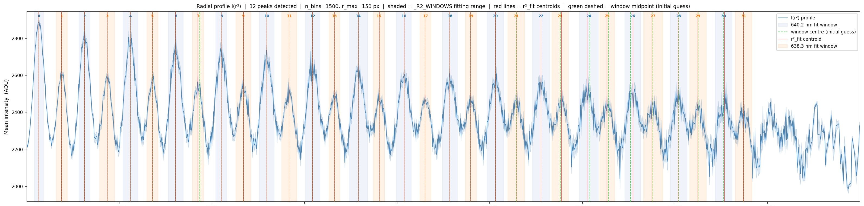
Steps 5 & 6 — Peak identification and fit diagnostics
Identifies and fits all 32 fringe peaks; produces the r²_fit centroids used by Tolansky
Figure 2 — Peak identification table
Figures 3a/3b — Per-peak fit diagnostics
Top panel: full radial profile I(r²) with
• shaded _R2_WINDOWS fitting bands
• green dashed centre-guess lines
• red centroid lines (r²_fit)
Bottom panel: peak table — λ, win lo/hi,
r²_raw, r²_fit, ±σ, amplitude, width, χ²_red
Font size 12.5 pt for readability
3a: P0–P19 (inner peaks, well-resolved)
3b: P20–P31 (outer peaks, lower SNR)
4-column grid of panels, one per peak.
Each panel: data ± SEM, parabola fit
(orange solid), detected centroid (gray dash),
fitted centroid (red) ± 1σ band.
Subtitle: f(r²)=A·r⁴+B·r²+C centroid=−B/(2A)
Fit model: parabola f(r²) = A(r²)² + B(r²) + C · A < 0 (opens downward) · centroid r²_fit = −B / (2A)
Peaks alternate 640.2 nm (even index) / 638.3 nm (odd index) · _R2_WINDOWS defines fitting bounds for each of the 34 expected peaks
fpi_cal_lib: _plot_all_fringe_diagnostics_r2(), PeakFitR2

Slide 7
Bridge — peaks_to_array()
Converts the list of PeakFitR2 objects into the float64 array consumed by run_tolansky_2line()
Output shape: (N_peaks, 10) float64 — one row per detected peak
Col 0
peak_idx
bin index of centroid
Col 1
r2_raw_px2
r² at detected bin (px²)
Col 2
r2_fit_px2
parabolic centroid ← Tolansky uses this
Col 3
sigma_r2_fit_px2
1σ uncertainty on col 2
Col 4
r_raw_px
√(r2_raw) for reference
Col 5
0.0
reserved
Col 6
amplitude_adu
peak amplitude (ADU)
Col 7
width_r2_px2
Gaussian σ in r²
Col 8
reduced_chi2
fit quality
Col 9
line_id
0.0 = 640.2 nm / 1.0 = 638.3 nm
Family assignment: even list index → line_id=0.0 (640.2 nm strong) | odd → line_id=1.0 (638.3 nm weak) — strict alternating interleave
fpi_cal_lib: peaks_to_array()

Slide 8
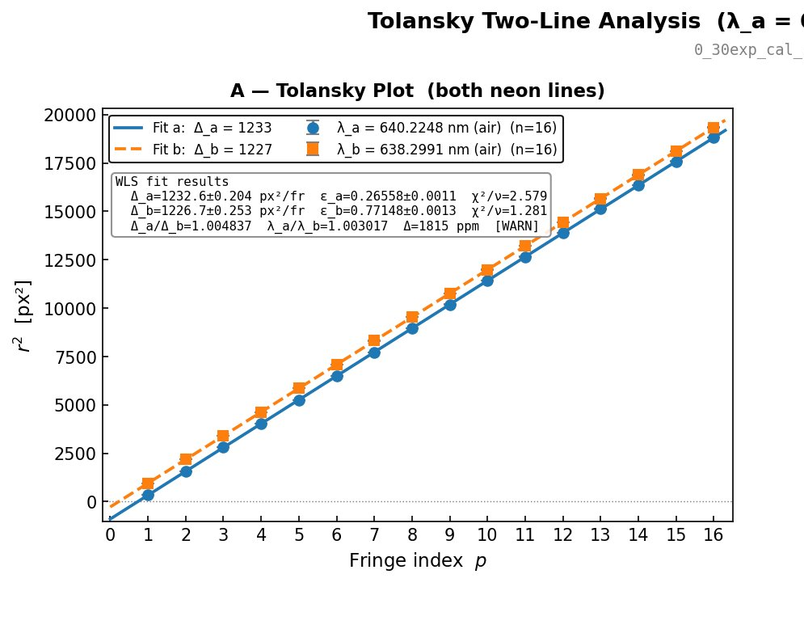
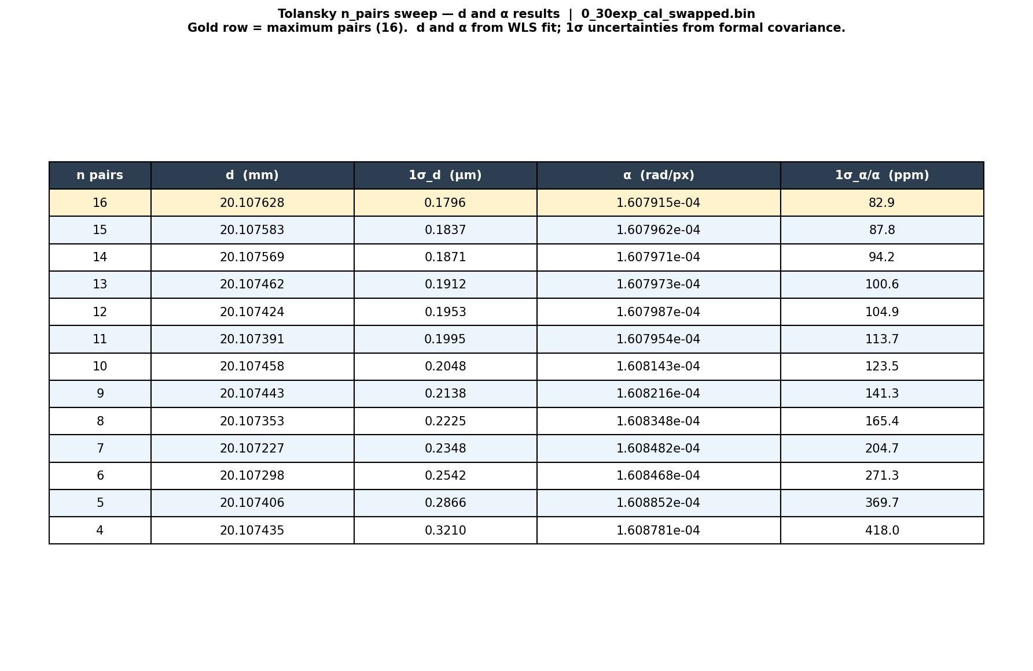
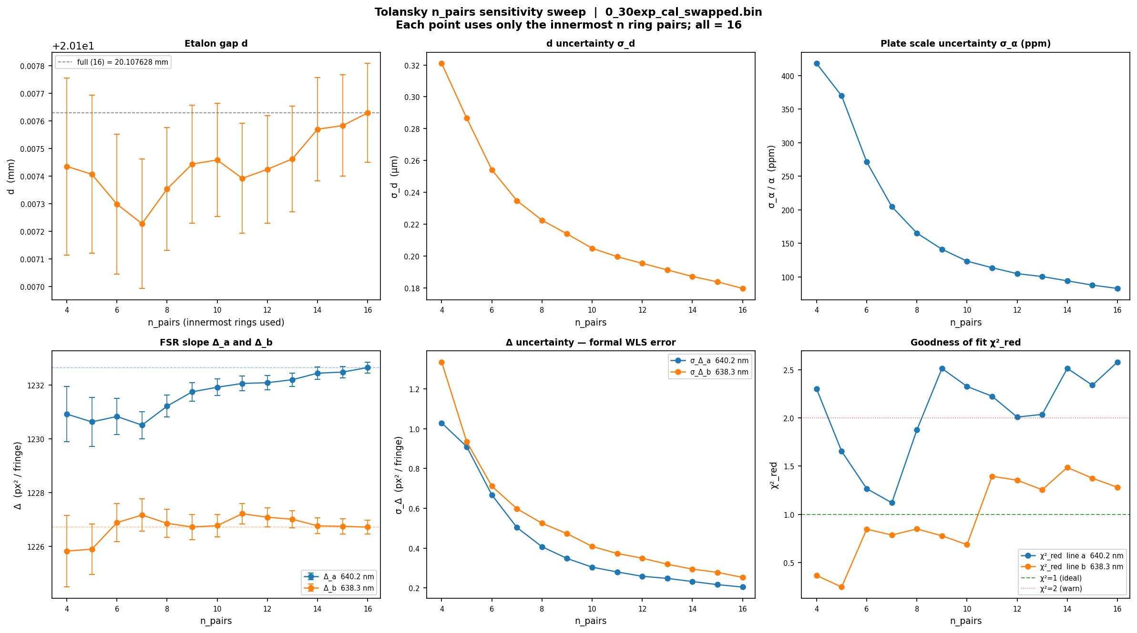
Step 7 — Tolansky two-line WLS analysis
Recovers etalon gap d, plate scale α, and fractional orders ε_a, ε_b from fringe peak positions alone
r²_p = Δ · p + b Δ = FSR spacing (px²/fringe) · ε = 1 + b/Δ (fractional order)
Line a — 640.2248 nm
Line b — 638.2991 nm
Benoit recovery
WLS fit → Δ_a, σ_Δ_a
ε_a = 1 + b_a/Δ_a
chi2/nu_a [PASS if < 2]
N_rings_a = 16 pairs
WLS fit → Δ_b, σ_Δ_b
ε_b = 1 + b_b/Δ_b
chi2/nu_b [PASS if < 2]
N_rings_b = 16 pairs
N_Δ from d_prior=20.008 mm
d = (N_Δ+ε_a−ε_b)·λ_a·λ_b
/ [2n(λ_b−λ_a)]
α = √(λ_a·n / (d·Δ_a))
Consistency checks
Fig 4: Tolansky 4-panel diagnostic
Fig 5: n_pairs sensitivity sweep (6 panels)
Fig 5b: d and α table by n_pairs
Δ_a/Δ_b vs λ_a/λ_b [PASS < 200 ppm] | |α_a − α_b| / α_a [PASS < 1000 ppm]
Y_B_obs = median(amp_b)/median(amp_a) [PASS if 0.15 – 0.60]
fpi_cal_lib: run_tolansky_2line(), plot_tolansky_result(), print_rectangular_array()

Slide 9
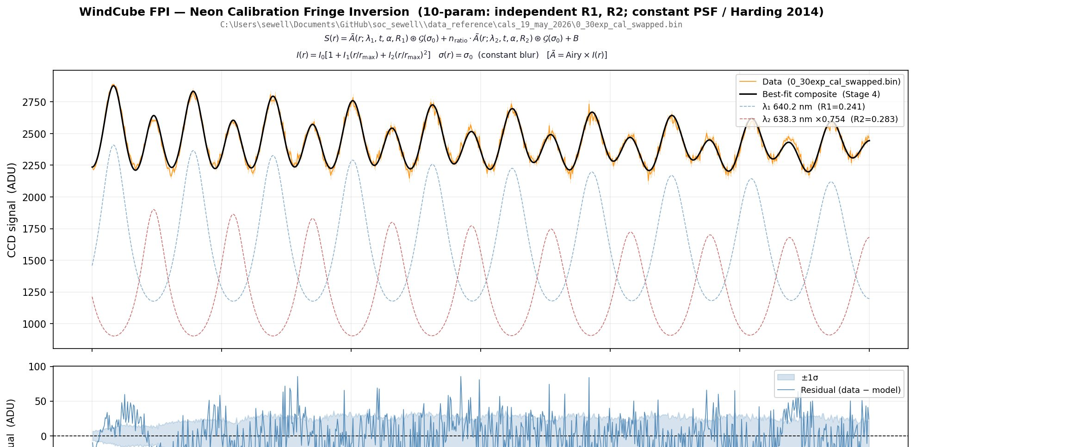
Tolansky → H05 handoff
What run_tolansky_2line() returns and how average_tolansky_seeds() wraps it for H05
TolanskyResult (from run_tolansky_2line)
average_tolansky_seeds()
d_m
etalon gap, metres ← seeds t_m in H05
Accepts a list of TolanskyResult.
For production: list of one (single frame).
Rejects frames with chi2/nu > 15.
Computes mean ± SEM for:
d_m_mean
alpha_mean
eps_a_mean
Delta_a_mean
Y_B_obs_mean
Returns TolanskySeedMean
→ passed directly to run_h05()
sigma_d_m
1σ uncertainty on d
alpha_mean
plate scale, rad/px ← seeds α in H05
sigma_alpha
1σ uncertainty on α
eps_a
fractional order, 640.2 nm ← phase_correct_gap()
sigma_eps_a
1σ uncertainty on ε_a
Y_B_obs
amp ratio 638/640 ← seeds ne_ratio_init
Delta_a
r²-spacing px²/fringe ← used to compute α
n_rings_a
ring pairs used = 16 ← figure annotation
→ H05 receives: TolanskySeedMean (d_m_mean, alpha_mean, eps_a_mean, Y_B_obs_mean) + FringeProfile + R1/R2/σ₀ init values
Covered in the H05 → H06 handoff deck ↗
fpi_cal_lib: run_tolansky_2line(), average_tolansky_seeds(), TolanskySeedMean

